Slide 1
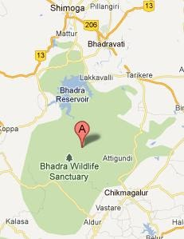
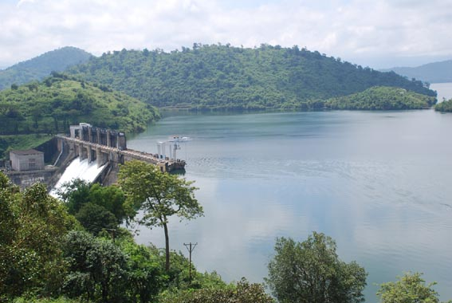
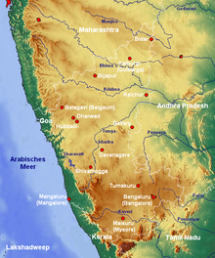
Assignment - 01 The state of Environment in Lakkavalli.
Submitted in partial fulfillment of the course requirements for Environmental Studies (BSDCH ZC225)
to Birla Institute of Technology and Science
by [Prathik T P, 202217b3639@wilp.bits-pilani.ac.in, Section-E]
Under the guidance of [Prof. Dr Ritu Singh Rajput]

Slide 2
Contents
 | Content | Page Number
1 | Introduction
2 | Climate, Water and Soil
3 | Native, Endemic and Invasive Species
4 | Agriculture, Horticulture and Animal Husbandry
5 | Industry
6 | Health and Wellbeing
7 | Literacy
8 | Case Study 1
9 | Case Study 2
10 | Case Study 3

Slide 3
INTRODUCTION
I am a 20 year old native of Lakkavalli in Chickmanglore district of Karnataka state. I am currently employed at HCL and work from Chennai location. I am from a middle class family background. I born and brought-up from a place where it’s fully surrounded with forest, nature and full of greenery. From my childhood I have much interest in farming, Gardening and plantation. In my family all my relations are having farming background and whenever I get time I’ll go and spend those precious time with nature because it gives some kind of calmness, refreshes mind and gives mental peace. As I spent most of my life time with nature I am much concerned about caring the nature, planting more plants and spreading the awareness of the nature to the upcoming generation.

Slide 4
CLIMATE, SOIL AND WATER RESOURCES
Lakkavalli belongs to the western Ghats of Karnataka which is a rich heritage in forest land and water resources. Climate will changes accordingly to the climate seasons. In rainy season will get more rain as it lays in the western Ghats of Karnataka and in winter it’ll be too cold as it’s covered with more trees and forest and in summer there won’t be much sunny days because our native is surrounded by more trees and forests. Talking about the soil, almost all the part of our land is covered with black soil and it’s rich in minerals which helps trees to get stable and much people will do the coconut farming. The major soil type in the district comprises of red loamy & sandy soil. In my native people will grow more coconut which is also called as BROWN DIAMOND. We have plenty of water resources as we will get more rain in the rainy season. Along with that we also have BHADRA DAM where two – three complete district is depend on this water. We also generate electricity with the help of turbines which are adopted in the dam. The generated electricity will flows across Karnataka. This helps so many farmers to yield their crops without any water dependency from another state.

Slide 5
Native Species, Endemic Species and Invasive Species
Native Species - Bhadra Tiger Reserve is home to about 40 species of large mammals, of which most are endangered. Tiger, Leopard, Leopard cat, Dholes, Indian Civet, ungulates like Gaur, Sambar and Barking Deer are common. Birdlife in the reserve is abundant, and around 250 species of avifauna have been identified.
Endemic Species - Bhadra Tiger Reserve is home to about 40 species of large mammals, of which most are endangered. Tiger, Leopard, Leopard cat, Dholes, Indian Civet, ungulates like Gaur, Sambar and Barking Deer are common..
Invasive Species - Bhadra Tiger Reserve is home to about 40 species of large mammals, of which most are endangered. Tiger, Leopard, Leopard cat, Dholes, Indian Civet, ungulates like Gaur, Sambar and Barking Deer are common. Birdlife in the reserve is abundant, and around 250 species of avifauna have been identified.

Slide 6
Agriculture, Horticulture, Animal Husbandry
Agriculture - My District is famous for its coffee cultivation and is known as the coffee land of Karnataka. Along with this we do have coconut farming also. Chikmagalur is one of the highest producers of coffee in the country, and the lifestyle and culture of Chikmagalur has evolved around this agrarian aspect.
Horticulture - Oil seeds like groundnut, sesamum, sunflower, castor and commercial crops like sugarcane, cotton, and tobacco are also grown here. Chikmagalur is the second largest coffee producing district in India, after Kodagu.
Animal Husbandry – In my village most of the people will do the cattle farming as we can use the cow dung as fertilizers to yield crops. The Karnataka Government has also introduced many schemes for this planning which will help farmers also to get some benifites. We do produce some quantity of milk from various types of cows.

Slide 7
Health and Wellbeing
In my village or district all are healthy and active as they do farming activities and we are living our lives with nature. We don’t face any much health issues in our village.

Slide 8
Case Study 1
As we are having the Bhadra wildlife sanctuary, we are seeing much usage of plastics which is harming the nature. So Karnataka government should implement some kind of policies for this. Apart from this we are good in taking care of the nature and wild animals which are present in our village surroundings.

